Slide 1
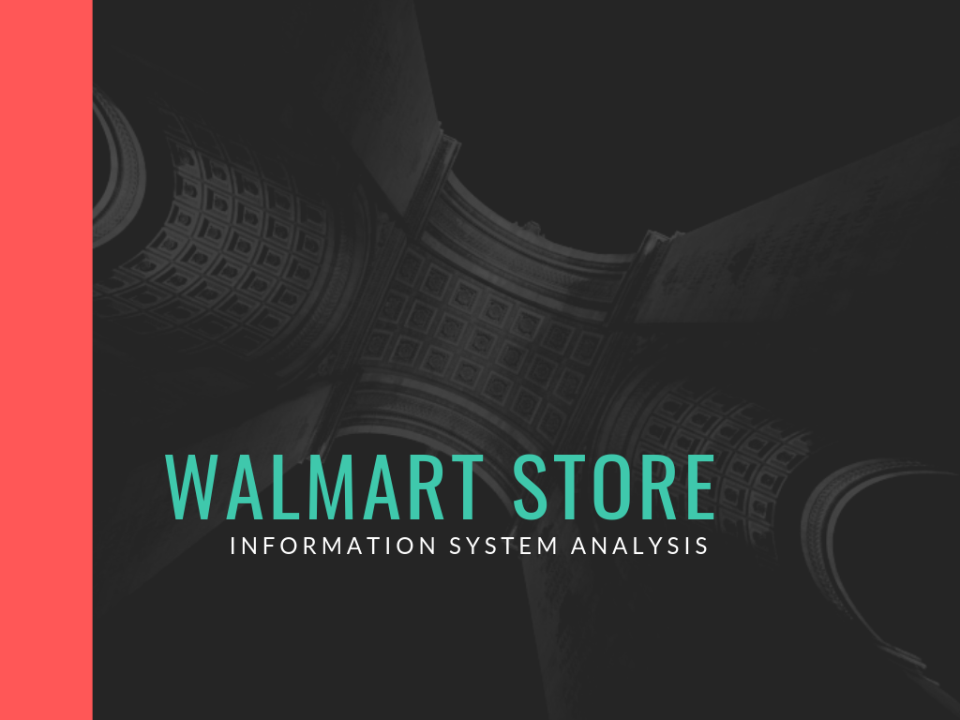
Notes:
This presentation analyses the implementation of information systems at Walmart's store by looking at what is there and recommending the necessary action and changes

Slide 2
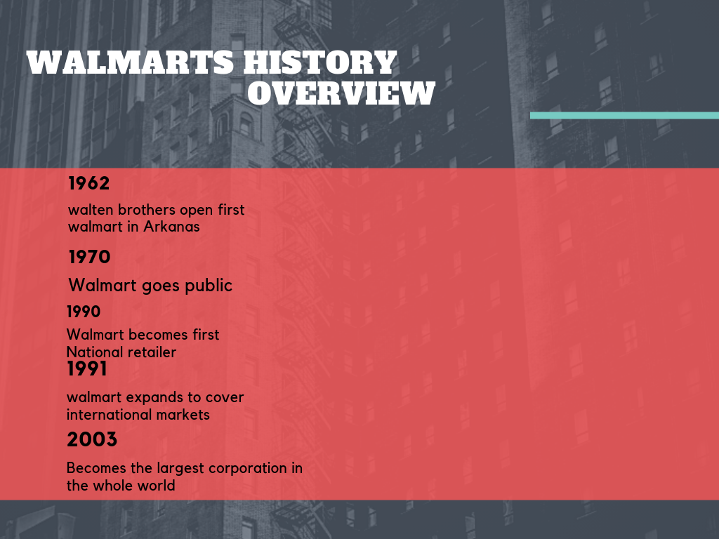
Notes:
Technology in the past 10 years has grown to be a fundamental organ of every business organization, making it inevitable. Additionally, the accelerated use of technology has pushed the creation of new strategies related to information communication technology in staying on top of the market. It has been established that whoever that effectively control information system controls the market. This makes information systems important in raising one's market competitiveness. As per its slogan ‘always low prices’ Walmart focuses its strategies to attain a competitive advantage through the offering of its merchandise at low prices.

Slide 3
Information systems at Walmart
The following are the information systems in place:
Customer relationship management system
Supply chain management system
Electronic data exchange system
Point of sale management system
Notes:
Walmart uses a business model that incorporates information technology systems in its major functionalities. The information technology systems adopted include the use of inventory, supply chain, supplier and customer management systems (Walmart, 2011). The adoption of information systems has helped in increasing the organization's efficiency in inter-departmental relationships.

Slide 4
Customer relationship Management
The customer relationship system (CRM) focuses on
Generating new and loyal customers
Collecting of valuable information about its customers
Stores customer and prospect contact information, accounts, leads, and sales opportunities in one central location
Allows businesses to manage business relationships and the data
Notes:
customer relationship -The customer relationship system (CRM) focuses on generating new and loyal customers through its technological capabilities of collecting valuable information about its customers. it also helps the organization learn and predict the needs of their customer through its interactions

Slide 5
Supply chain management
Manages the flow of goods and services, the main functions of a supply chain management are to manage:
The flow of goods
Storage of raw materials
Work in process inventory
Finished goods from point of origin to point of sale
Notes:
The supply chain distribution center, this system plays the role distribution (wholesaler). The supply information system is responsible in the flow of service and goods this is comprised of the storage and the movement raw materials, goods under processing and processed goods from the starting point to the end point.

Slide 6
Electronic Data Exchange system
Is responsible for dealing with electronic exchange documents of the enterprise.
Documents are exchanged between Walmart and its partners in a paperless medium.
This documents include
Pay slips
Catalogues
Invoices
Delivery slips
Notes:
Is responsible for dealing with electronic exchange documents of the enterprise, these documents include orders, invoice and delivery slips (Wu, 2015).he documents are mostly shared exchanged between Walmart and its partners in a paperless medium

Slide 7
Point of sale systems
This system makes it possible for the organization to track its inventories (Barnejees,2000)
Highly efficient I facilitating quick deliveries
Its collects data from its users (Customers)
Records and analyses data
Manages scheduling and payroll
Keeps track ad pattern of stock levels
Notes:
The enterprise has also adopted the use of point of sale information systems (POS), this system makes it possible for the organization to track its inventories (Barnejees,2000). This makes it possible for Walmart to collect valuable data from their customer’s characteristics as well as stock levels. This was due to the growing need of having a fast delivery system.

Slide 8
Advantages of Information systems
Facilitates quick communication between business and their partners
Makes supervision of the movement of goods easy
Narrows the cultural gap
Its cost effective
Reduces the risk of errors and mistakes
Provides for real time data.
Notes:
Real Time Data
Through having integrated information in one system, all of the data is up to date. This is essential for all elements of the organization ranging from marketing communications through to finance.
Reduced Risk of Errors
Due to the fact that data will not have to be replicated, there is less chance of human errors being made which leads to more accurate information available.
Better Communication
Team members will be able to communicate better through having exactly the same information available to them at each time. Its saves having to mis-match data between systems and departments.

Slide 9
Continuation
Through the adoption of Big data Walmart has been able to:
To improve its stores checkout
Its efficiency levels have gone high
Improved o product assortment
Improved on personalized shopping
Notes:
Through Walmart's big data they are now able to personalize customers shopping through learning of their preference. Since the implementation of big data Walmart has been able optimize their assortment designs through the thorough analysis of customers preference and patterns

Slide 10
Ethical concerns
Walmart systems have factored in the 5 principles of information systems:
  Notice/awareness (core principle)
  Choice/consent (core principle)
  Access/participation
  Security
  Enforcement
Notes:
The process of preventing and detecting unauthorized use of your computer. Prevention measures help you stop unauthorized users (hackers) from accessing any part of your computer system. Walmart have factored I the above principles in designing and implementing their systems

Slide 11
Recommendations
Walmart needs to balance its use of technology and human interaction.
The store should adopt a digital service that can be integrated to every physical store.
An implementation of this will:
Walmart will gain a competitive advantage
The store will boost their customers relations
There will be an increase in revenue
Notes:
The enterprise needs to balance its use of technology and human interaction.
Everyone is turning into online purchases, it will important if the retail chain store adopts a digital service that can be integrated to every physical store to facilitate an in-store pickup delivery system to help the store in attaining a competitive advantage.( An example of this can be like an online grocery store)

Slide 12
Reference
Wood, R. C. (2017, June). Bringing large technology systems to economic maturity. In Technology & Engineering Management Conference (TEMSCON), 2017 IEEE (pp. 432-436). IEEE.
Hugos, M. H. (2018). Essentials of supply chain management. John Wiley & Sons.
Pothukuchi, H., Gonzalez, N., & Solera, E. (2017). U.S. Patent No. 9,576,260. Washington, DC: U.S. Patent and Trademark Office.
Bassamboo, A., Moreno, A., & Stamatopoulos, I. (2018). Inventory auditing and replenishment using point-of-sales data. Available at SSRN 2515147.
Hofmann, E. (2017). Big data and supply chain decisions: the impact of volume, variety and velocity properties on the bullwhip effect. International Journal of Production Research, 55(17), 5108-5126.

